Slide 1

Retail Store Analysis Project

Slide 2
Abstract
A retail store analysis project involves designing and implementing a database system to support the functionalities of an shopping platform. The system typically includes tables to store customer information, product details, orders, order details, and optionally, reviews.
The purpose of the retail store analysis project is to create a robust and efficient database system that can handle various aspects of an shopping experience. It allows customers to browse products, add them to their cart, place orders, and leave reviews. Additionally, it provides administrators with tools to manage products, orders, and customer information.

Slide 3
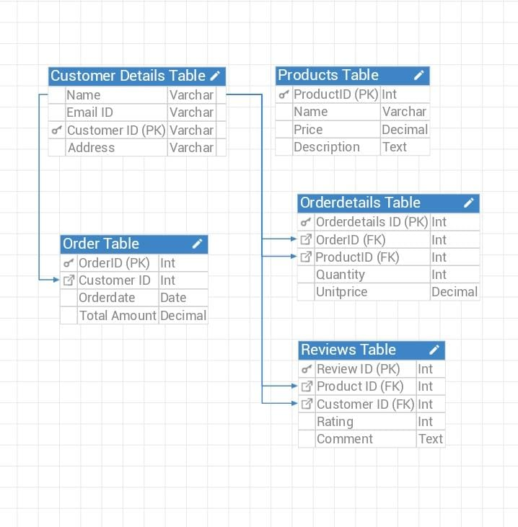
ER Diagram

Slide 4
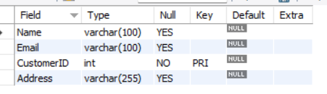
Structure of the Customer Table
This table shows the information of the customers.
Syntax : desc customers;

Slide 5
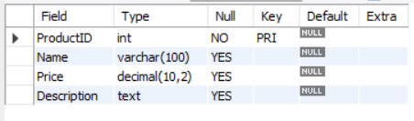
Structure of the Products Table
This table shows the information about the products.
Syntax : desc products;

Slide 6
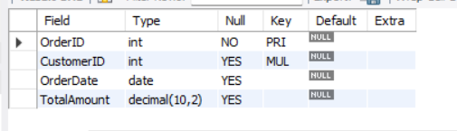
Structure of the Order Table
This table shows the details of orders like Order_ID, Custome_ID, Orderdate and Totalamount.
Syntax : desc orders;

Slide 7
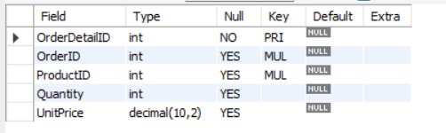
Structure of the Order details Table
This table shows the information about the order details
Syntax : desc orderdetails;

Slide 8
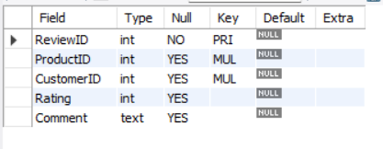
Structure of the Reviews Table
This table shows the information about the reviews received from the customers like rating, comments.
Syntax : desc reviews;

Slide 9
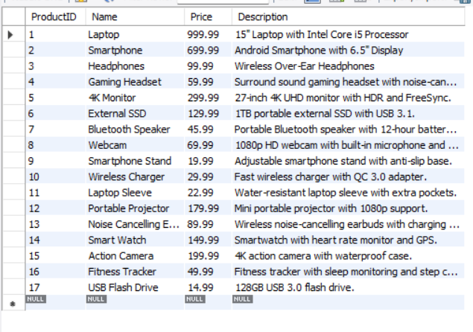
Contents of the Products Table
Syntax : select * from Products;

Slide 10
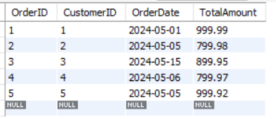
Contents of the Order Table
Syntax : select * from orders;

Slide 11
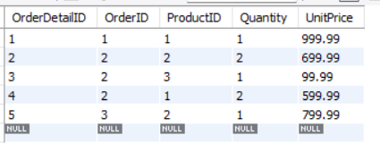
Contents of the Orderdetails Table
Syntax : select * from orderdetails;

Slide 12
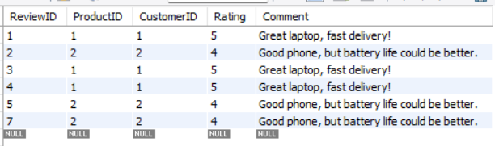
Contents of the Reviews Table
Syntax : select * from Reviews;

Slide 13
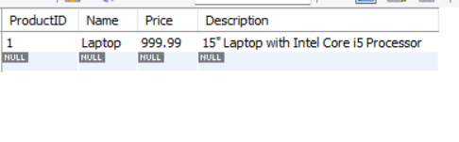
Subqueries
1. Subquery to List Products Ordered by a Specific Order
SELECT * FROM ProductsWHERE ProductID IN (SELECT ProductID FROM OrderDetails WHERE OrderID = 1);

Slide 14
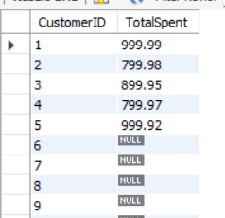
Subqueries
2. Subquery to Calculate the Total Amount Spent by Each Customer
SELECT CustomerID, (SELECT SUM(TotalAmount) FROM Orders WHERE Orders.CustomerID = Customers.CustomerID) AS TotalSpent FROM Customers;

Slide 15
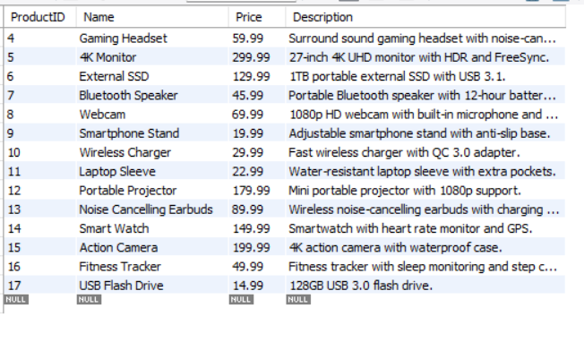
Subqueries Retrieve all products that have never been ordered.
3. Subquery to Find Products That Have Not Been Ordered
SELECT * FROM Products
WHERE ProductID NOT IN (
SELECT DISTINCT ProductID FROM OrderDetails);

Slide 16
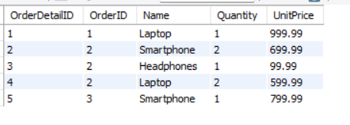
JOINS
SELECT OrderDetails.OrderDetailID, OrderDetails.OrderID, Products.Name, OrderDetails.Quantity, OrderDetails.UnitPrice
FROM OrderDetails
INNER JOIN Products ON OrderDetails.ProductID = Products.ProductID;
Retrieve Order Details with Product Information with the help of Inner Join

Slide 17
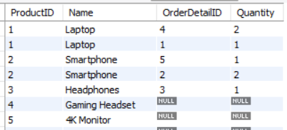
JOINS Retrieve all products and their order details(if any) (Left Join)
SELECT Products.ProductID, Products.Name, OrderDetails.OrderDetailID, OrderDetails.QuantityFROM Products
LEFT JOIN OrderDetails ON Products.ProductID = OrderDetails.ProductID;

Slide 18
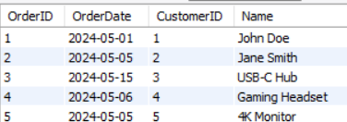
JOINS Retrieve all orders and corresponding customers.
SELECT Orders.OrderID, Orders.OrderDate, Customers.CustomerID, Customers.Name
FROM Orders
RIGHT JOIN Customers ON Orders.CustomerID = Customers.CustomerID;

Slide 19
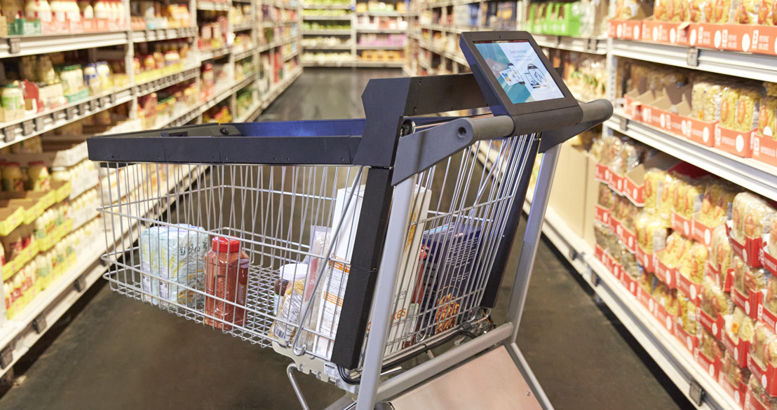
Prepared by :
Goske. Priyanka

